Slide 1


Travel Analytics Dashboard Insights
This presentation analyzes key travel data for a ride-sharing platform, highlighting key performance metrics and insights.
by Sai Snehanth

Slide 2
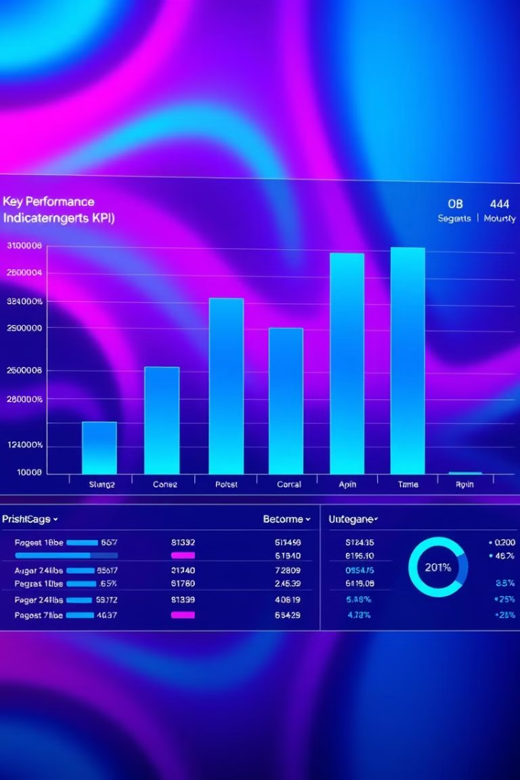
Key Metrics Overview
1
Total Passengers
2
New Passengers
The total number of passengers is 238,000, falling short of the target of 325,333.
A significant number of new passengers, 185,100, suggests strong customer acquisition.
3
Repeat Passengers
4
Total Trips
Repeat passengers contribute a smaller but stable proportion, highlighting potential for loyalty programs.
The total number of trips reached 429,000, indicating high activity on the platform.

Slide 3
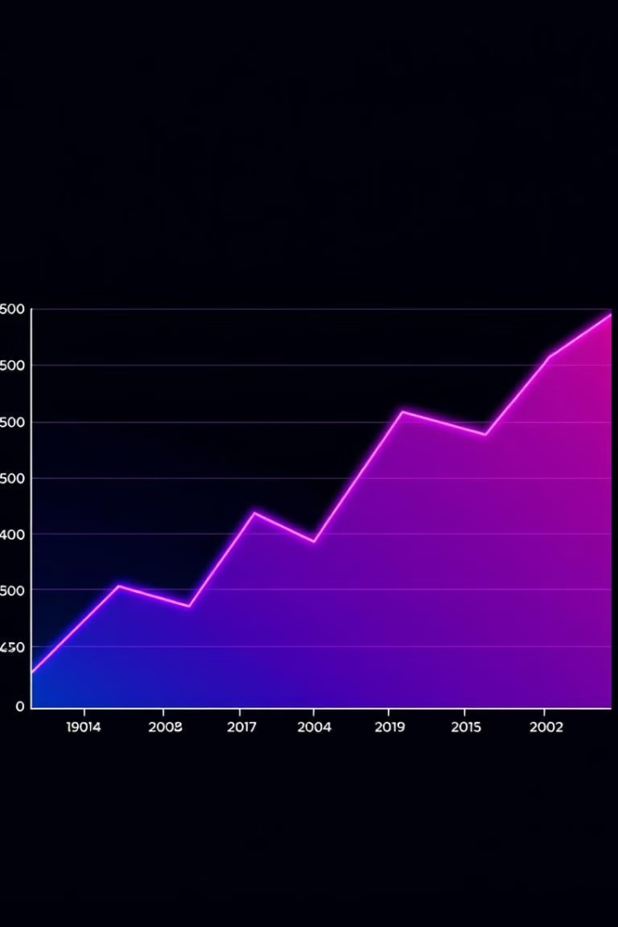
Passenger Trends
1
Consistent Monthly Growth
The total number of passengers demonstrates consistent growth each month.
2
High Passenger Counts in Quarter 2
Jaipur (RJ01) and Kochi (KL01) experienced increased travel activity during Q2.
3
Repeat Passengers
Repeat passengers represent a smaller but stable proportion, indicating potential for loyalty programs.

Slide 4
Geographic Insights
Top-Performing Cities
Andhra Pradesh Growth Potential
Jaipur (RJ01): 34,000 passengers
Andhra Pradesh (AP01) exhibits high growth potential due to factors like:
Kochi (KL01): 26,000 passengers
Lucknow (UP01): 24,000 passengers
Sum of fare amount: $179-$181
Sum of distance traveled: 25-35 km

Slide 5
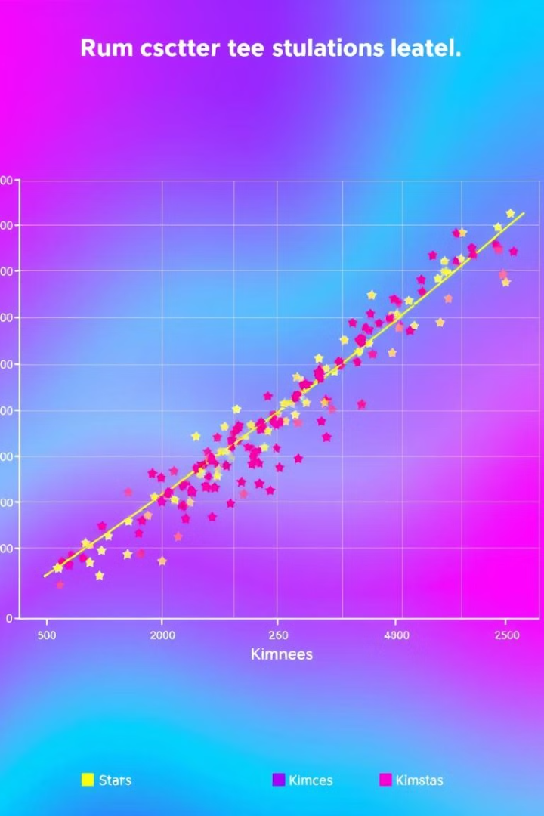
Driver and Passenger Ratings Analysis
City
Average Driver Rating
Passenger Retention
Coimbatore (TN01)
High
Strong
Kochi (KL01)
High
Strong

Slide 6

New vs. Repeat Passenger Trends
New Passengers
Repeat Passengers
New passengers dominate monthly trends, especially in Jaipur (RJ01) and Kochi (KL01).
Repeat passengers maintain steady growth, highlighting loyalty opportunities.
Jaipur (RJ01)
Engagement Opportunities
Jaipur has the highest repeat passenger count at 31,000.
Surat (GJ01) and Chandigarh (CH01) offer opportunities for increased passenger engagement.

Slide 7




Financial and Operational Metrics
Distance and Driver Ratings
Distance traveled correlates with driver ratings, with the highest rating (9) associated with the most distance traveled.
Fare Ranges
There is a 15.62x likelihood increase for fare amounts $179-$181 in Andhra Pradesh (AP01).
Fare Range Analysis
There is a 4.05x increase in likelihood for fare amounts $181-$517.

Slide 8






Strategic Recommendations
Expand Marketing
Customer Retention
Focus marketing efforts in high-performing cities like Jaipur (RJ01) and Kochi (KL01).
Develop strategies to enhance customer retention among repeat passengers.
Service Quality
Fare Adjustments
Leverage high driver and passenger ratings to promote exceptional service quality.
Explore fare adjustments to optimize profitability in key areas.
POWER BI DASHBOARD LINK
GITHUB LINK

